Slide 1

(AUTONOMOUS)
Affiliated to JNTUH, Approved by AICTE, Accredited by NAAC with A++ Grade, ISO 9001:2015 Certified
Kacharam, Shamshabad, Hyderabad – 501218, Telangana, India
Department of Computer Science and Engineering
AI-Based Intelligent Retrieval of Large-Scale Scientific Imaging Data
BATCH ID : 24MPCS-B17
S. No | Roll Number | Student Name
1 | 24881A0586 | Gollakota Charan Deep
2 | 24881A05B5 | Pooja Vunnam
3 | 24881A05B7 | Pranet Pallati
Guide Details
Ms. C. Bhavana
Assistant Professor
Department of CSE

Slide 2
Mini Project Review-1 Outlines
Main idea of the Project
Existing System Vs Proposed
Proposed Project Objectives
Proposed Project Outcomes
Process Model
Architectural Diagram
Software and Hardware Requirements
Summary of First Review
All the Best
DEPARTMENT OF CSE MINI PROJECT REVIEW-I
2

Slide 3
Main idea of the Project
Modern scientific research (materials science, medical imaging, nanotechnology, semiconductor manufacturing) generates massive X-ray and microscopy image collections, often reaching terabyte–petabyte scale.
Traditional file-based and metadata-only storage systems cannot understand the visual content of these images, forcing researchers to manually search, de-duplicate and analyze huge volumes of data.
This project proposes an AI-Powered Intelligent Scientific Image Data Management System that combines Data Science, Computer Vision and Deep Learning to manage massive imaging datasets.
Core capabilities: automatic image preprocessing, AI-based metadata generation, duplicate/near-duplicate detection, deep image embeddings, similarity-based retrieval, anomaly detection and natural-language search.
Goal: act as an intelligent research assistant that reduces manual effort, improves data accessibility and accelerates scientific discovery.
DEPARTMENT OF CSE MINI PROJECT REVIEW-I
3

Slide 4
Existing System Vs Proposed
Aspect | Existing System | Proposed System
Data focus | Storage of raw images and basic metadata only | Storage plus AI-based understanding of image content
Metadata generation | Manual entry by researchers | Automatic metadata generation from image content
Duplicate handling | Not supported / manual checking | Automated duplicate & near-duplicate detection
Search mechanism | File name / folder based browsing | Similarity-based retrieval & natural-language search
Anomaly / defect detection | Not supported | AI-based anomaly detection on image samples
Examples | NexusLIMS, OME-NGFF (organize/store data) | Proposed AI-Powered Image Data Management System
Scalability to TB/PB data | Limited, mostly manual coordination | Scalable architecture extensible to HPC environments
DEPARTMENT OF CSE MINI PROJECT REVIEW-I
4

Slide 5
Proposed Project Objectives
Develop an AI-powered system to efficiently manage and organize large-scale X-ray and microscopy image datasets.
Automate image preprocessing and metadata generation to improve data quality and reduce manual effort.
Detect duplicate and near-duplicate images to improve storage efficiency and dataset organization.
Generate deep image embeddings and enable similarity-based retrieval for finding visually relevant scientific images.
Implement anomaly detection and intelligent search to identify unusual samples and support natural-language and metadata-based queries.
DEPARTMENT OF CSE MINI PROJECT REVIEW-I
5

Slide 6
Proposed Project Outcomes
A functional AI-powered platform capable of managing large collections of X-ray and microscopy images.
Automatic generation of metadata for scientific images, significantly reducing manual effort.
Reduced redundant storage through duplicate and near-duplicate image detection.
Fast retrieval of relevant images using similarity search and intelligent querying.
Anomaly detection and intelligent querying through natural-language and metadata-based search, with an architecture extensible to large research datasets.
DEPARTMENT OF CSE MINI PROJECT REVIEW-I
6

Slide 7
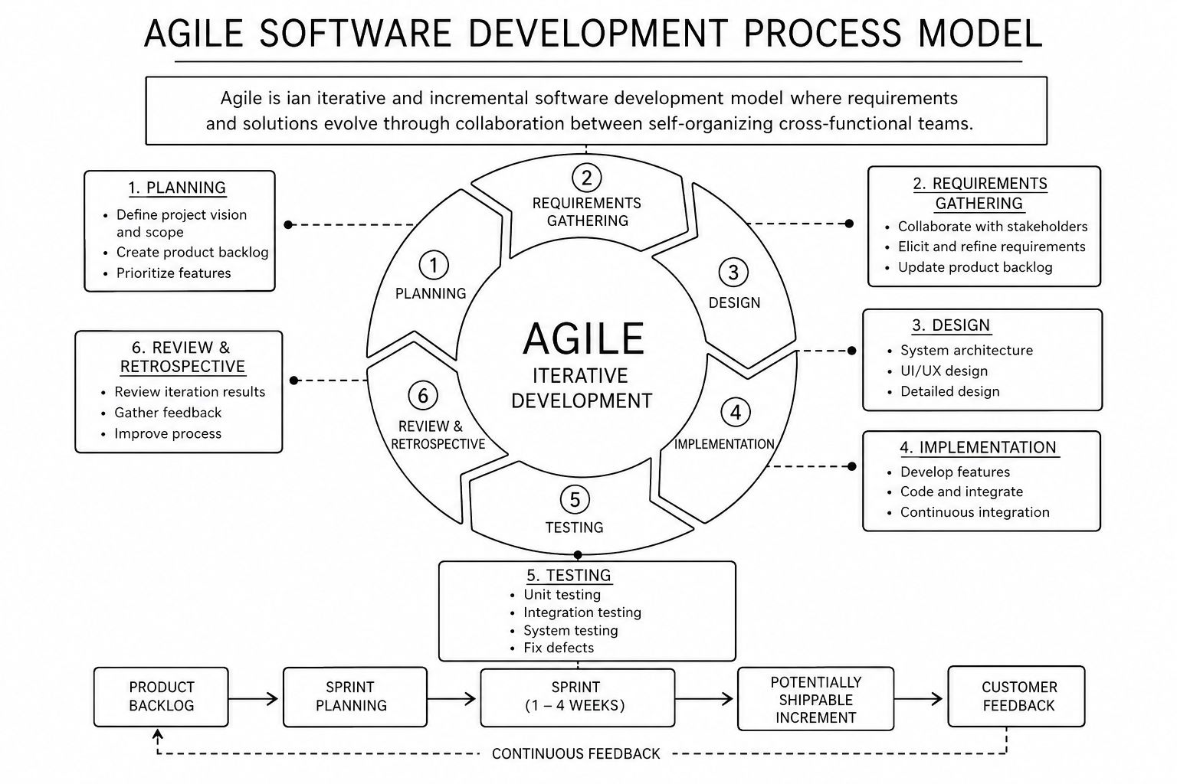
Process Model
DEPARTMENT OF CSE MINI PROJECT REVIEW-I
7

Slide 8
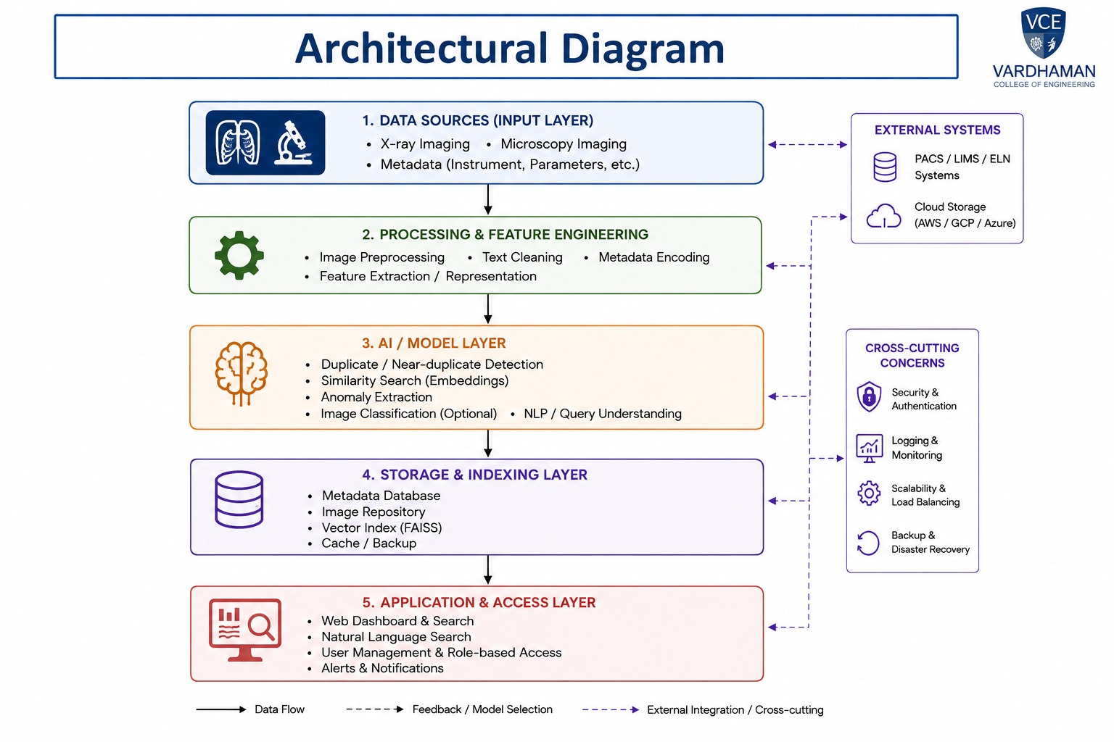
DEPARTMENT OF CSE MINI PROJECT REVIEW-I
8

Slide 9
Software & Hardware Requirements
Software Requirements
Programming Language | Python 3.x
Deep Learning Frameworks | PyTorch / TensorFlow
Computer Vision Libraries | OpenCV, scikit-image
Similarity Search / Vector Index | FAISS / Milvus
Backend Framework | Flask / FastAPI
Frontend / Dashboard | React.js, HTML5, CSS3
Database | MongoDB / PostgreSQL
Version Control & Deployment | Git, Docker
Operating System | Ubuntu 20.04+ / Windows 10/11
Hardware Requirements
Processor | Intel i5 / Ryzen 5 or higher (multi-core)
GPU | NVIDIA CUDA-enabled GPU (RTX 3060 or higher) for model training/inference
RAM | 16 GB minimum, 32 GB recommended
Storage | 512 GB SSD minimum for datasets, embeddings and indices
Network | High-speed connectivity for large dataset transfer
DEPARTMENT OF CSE MINI PROJECT REVIEW-I
9

Slide 10
Summary of First Review
Problem identified: scientific facilities generate TB–PB-scale X-ray and microscopy image collections that existing storage systems organize but do not intelligently understand.
Literature survey of 30 references completed, covering scientific metadata standards, microscopy/X-ray analysis, visual representation learning, retrieval and anomaly detection.
Research gap confirmed: no single platform integrates metadata generation, duplicate detection, embeddings, similarity search, anomaly detection and NL retrieval for scientific imaging.
Project objectives, expected outcomes and system architecture finalized for the proposed AI-powered image data management platform.
Next steps: implement image preprocessing and metadata-generation modules, followed by embedding-based similarity search and anomaly detection.
DEPARTMENT OF CSE MINI PROJECT REVIEW-I
10

Slide 11
Thank You
DEPARTMENT OF CSE MINI PROJECT REVIEW-I
11

